Slide 1


A Comprehensive Study on Credit Card Fraud Detection: Utilizing Feature Fusion Engineering and XAI
By
Al Mahmud Siam
Md. Mostafijur Rahman
SID: 1902062
SID: 1902073
Date: 29/09/2024

Slide 2
Outline
Introduction
State of the Problem
Objectives
Recent Benchmark Studies
Dataset Description
Dataset Handling
Proposed Framework
Feature Selection Techniques
Genetic Algorithm(GA)
Principal Component Analysis(PCA)
Ensemble Learning(Voting)
Cross Validation
Experiments results of Cross validation
Experiments results(methods)
Model Selection
Performance Metrics Visualization
Explainable Artificial Intelligence(XAI)
Comparing with other Works
Limitation
Conclusion
References
Submission of Paper
Notes:
Todays presentation we decorated with 22 subsection. Significant of them are recent bench mark studies, our proposed frame work,

Slide 3

Introduction
Credit Card is a plastic card issued to users as a System of e-Payment.
Credit Card Security relies on the Physical Security of the plastic card and the privacy of the Credit Card Number.
Globalization and increased use of Internet has resulted in a considerable proliferation of Credit Card Transactions throughout the world.
Credit Card Fraud is termed as a criminal duplicity, allowing fraudsters to gain financial benefits.
Need to prevent fraudulent activities using modern technology.

Slide 4
Statement of the Problem
With the immense use of the internet, fraudulent transactions increased day by day so the cardholders fell in financial losses.
Modern technology such as machine learning techniques is used to prevent the issue.
By analyzing past credit card transactions, using the knowledge of those that were identified as fraudulent.

Slide 5
Objectives
The primary objective of credit card fraud detection is to identify unauthorized or fraudulent transactions.
Detecting and preventing fraudulent transactions help minimize financial losses for both cardholders and financial institutions.
Building and maintaining customer trust.
When customers feel confident that their transactions are secure, they are more likely to continue using credit cards for payments..
Contributes to the overall security of the payment ecosystem.

Slide 6
Recent Benchmark Studies
Ref. | Dataset | Model | Accuracy | Limitation
[1] | Europeans credit cardholders (ECC) | KNN | Sensitivity: 81.19 %, Precision: 91.11 % | Dataset is imbalance, KNN is time-consuming; does not utilize accuracy as a performance metric due to its insensitivity to imbalanced data.
[2] | Don’t Specified | HMM | Around 80% | Training complexity and computational cost, current state only depends on the previous state, not the entire history.
[3] | ECC | GA- ANN | 99.94 % | Time-consuming for training model.
[4] | National Bank Credit Card | ANN | 94.62% | Less accuracy in fraud detection causes financial loss, ANN is a time-consuming process, when the feature column increases the model becomes more complex.

Slide 7
Recent Benchmark Studies(Contd.)
Ref. | Dataset | Model | Accuracy | Limitation
[5] | ECC | KNN | 75% | Less accuracy; fraud is not detected during transactions; financial loss.
[6] | ECC | Ensemble Majority vote | 99.95% | Data imbalance is a lacking, ANN is time consuming for large dataset.
[7] | ECC | LR | 97.46% | Low precision and F1 score significantly affects its overall performance.
[8] | ECC | CS-SVM | 98% | Prone to parameter sensitivity and computationally expensive for large dataset like CCF.

Slide 8
Recent Benchmark Studies(Contd.)
Ref. | Dataset | Model | Accuracy | Limitation
[9] | ECC | SVM | 97.5% | High-dimensional data, SVM is time-consuming for a large dataset to train.
[10] | ECC | PSO-RF | 99.92% | High dimensional data, balancing dataset is not issued.
[11] | Nigeria bank | NN | 95% | Doesn’t work if the transactions are not based on the real-time, computationally expensive.
[12] | Not Mentioned | ANN and BackPropagation | 99.92% | Time-consuming and computationally complex, prone to Overfitting.

Slide 9
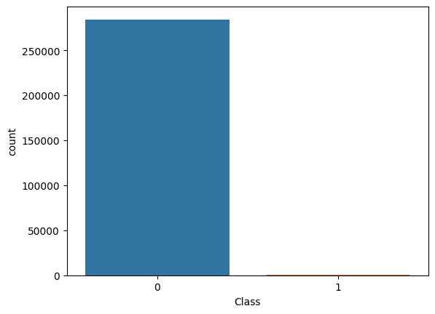
Dataset Description
Dataset Collection:
From Kaggle [13] (European cardholders' September 2013 MasterCard transactions)
Dataset Characteristics:
Size of Dataset: 63MB
Type: imbalanced (only 492 cases of fraud out of 284807 )
No. of features: 31
No missing values
No. of observations: 284,807
Experimental configuration:
The experimental processes were conducted on Kaggle.
The compute specifications are as follows:
Processor: Intel(R) Core(TM) i5-8265U CPU @ 1.60GHz
1.80 GHz
System type: 64-bit operating system, x64-based processor
Figure. Class Distribution of Dataset

Slide 10
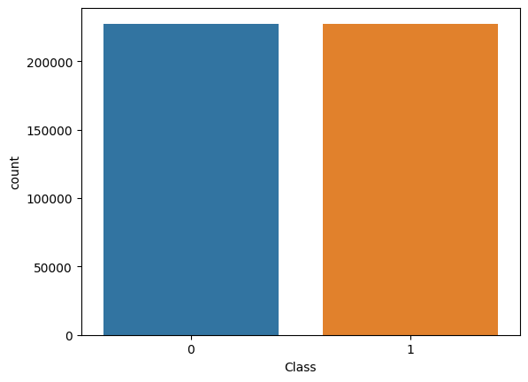
After creating SMOTE the Class is fully balanced
Class 0 and 1 contains 227451 samples both
Dataset Handling
Class Distribution Before Applying SMOTE on training dataset
Class Distribution After Applying SMOTE on training dataset
Before creating SMOTE the Class is highly imbalanced
Class 0 and 1 contains 227451 and 394 samples respectively

Slide 11
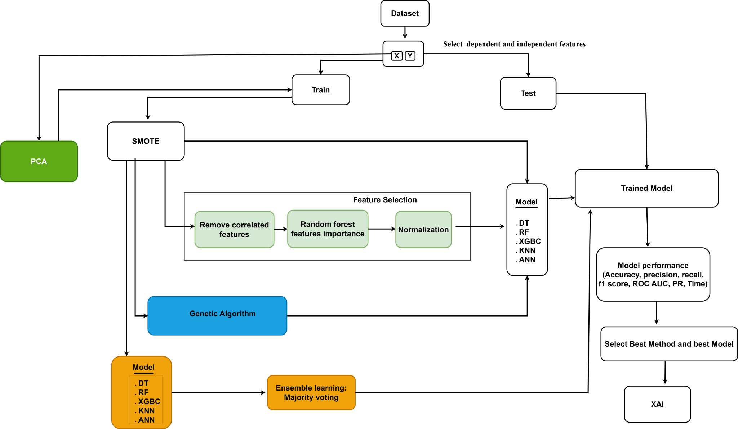
Proposed Framework

Slide 12
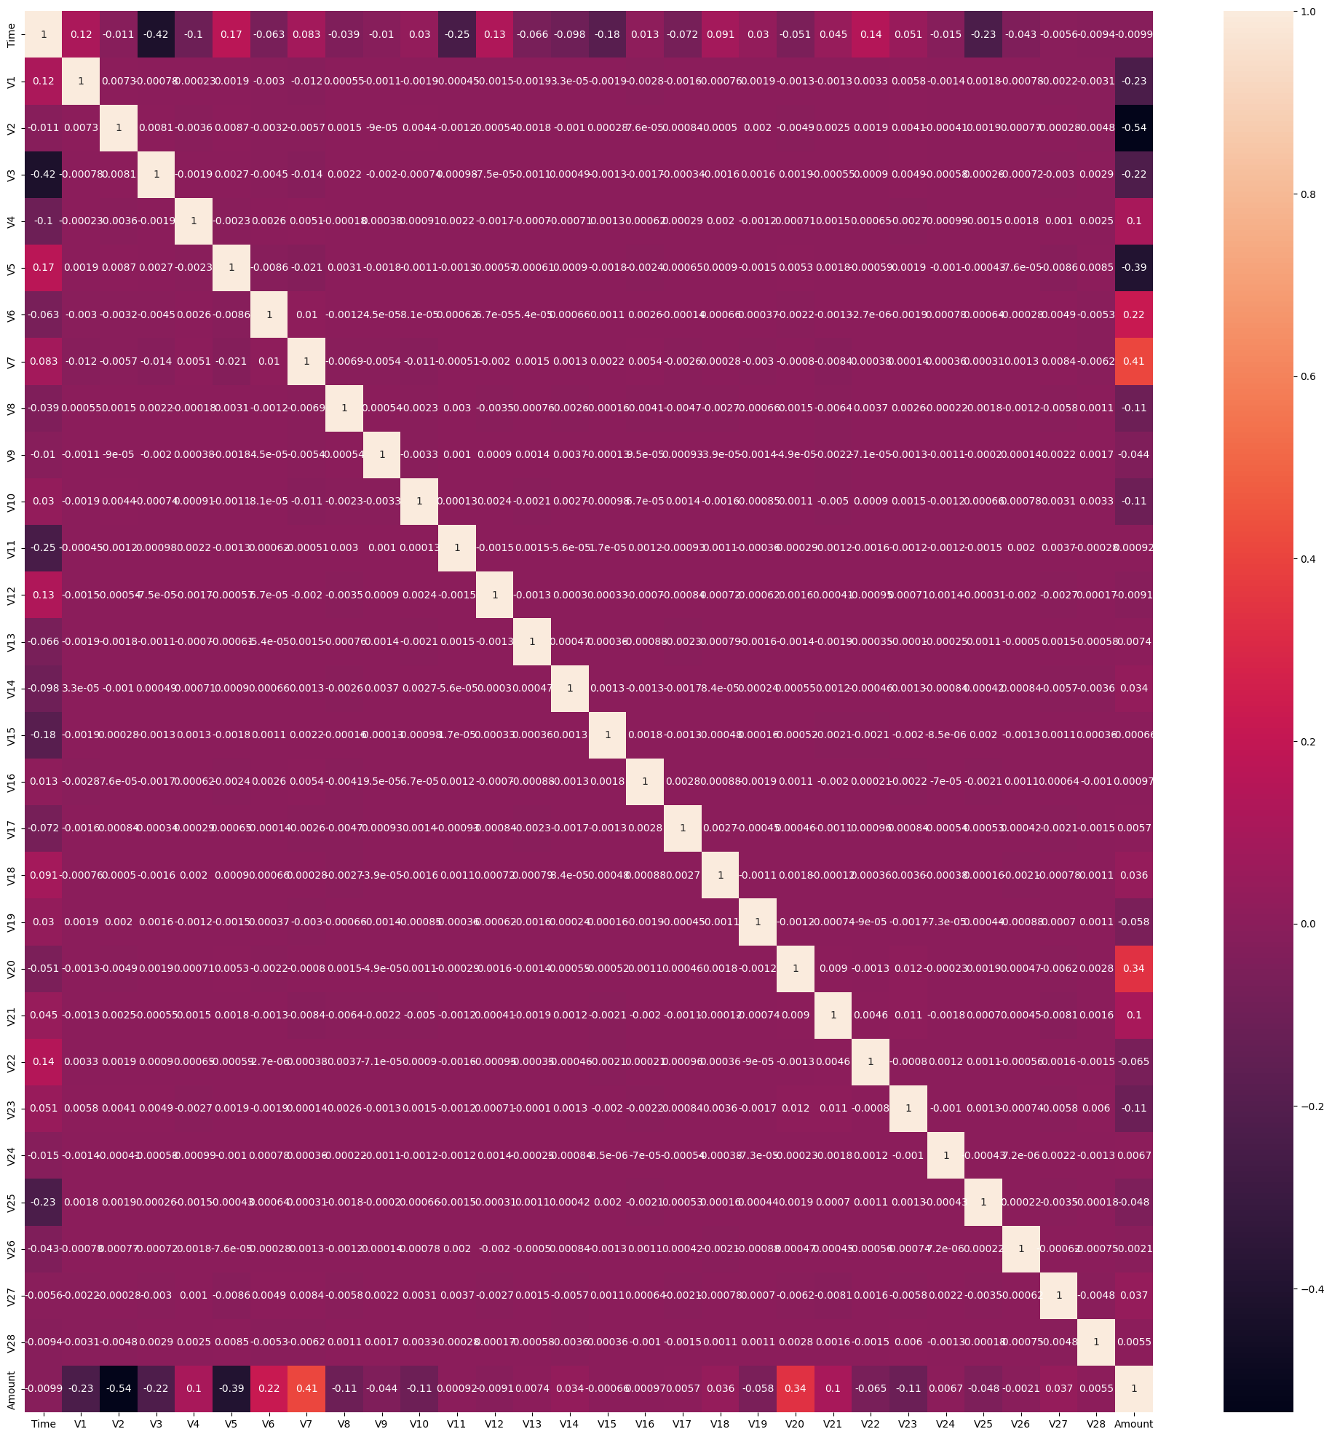
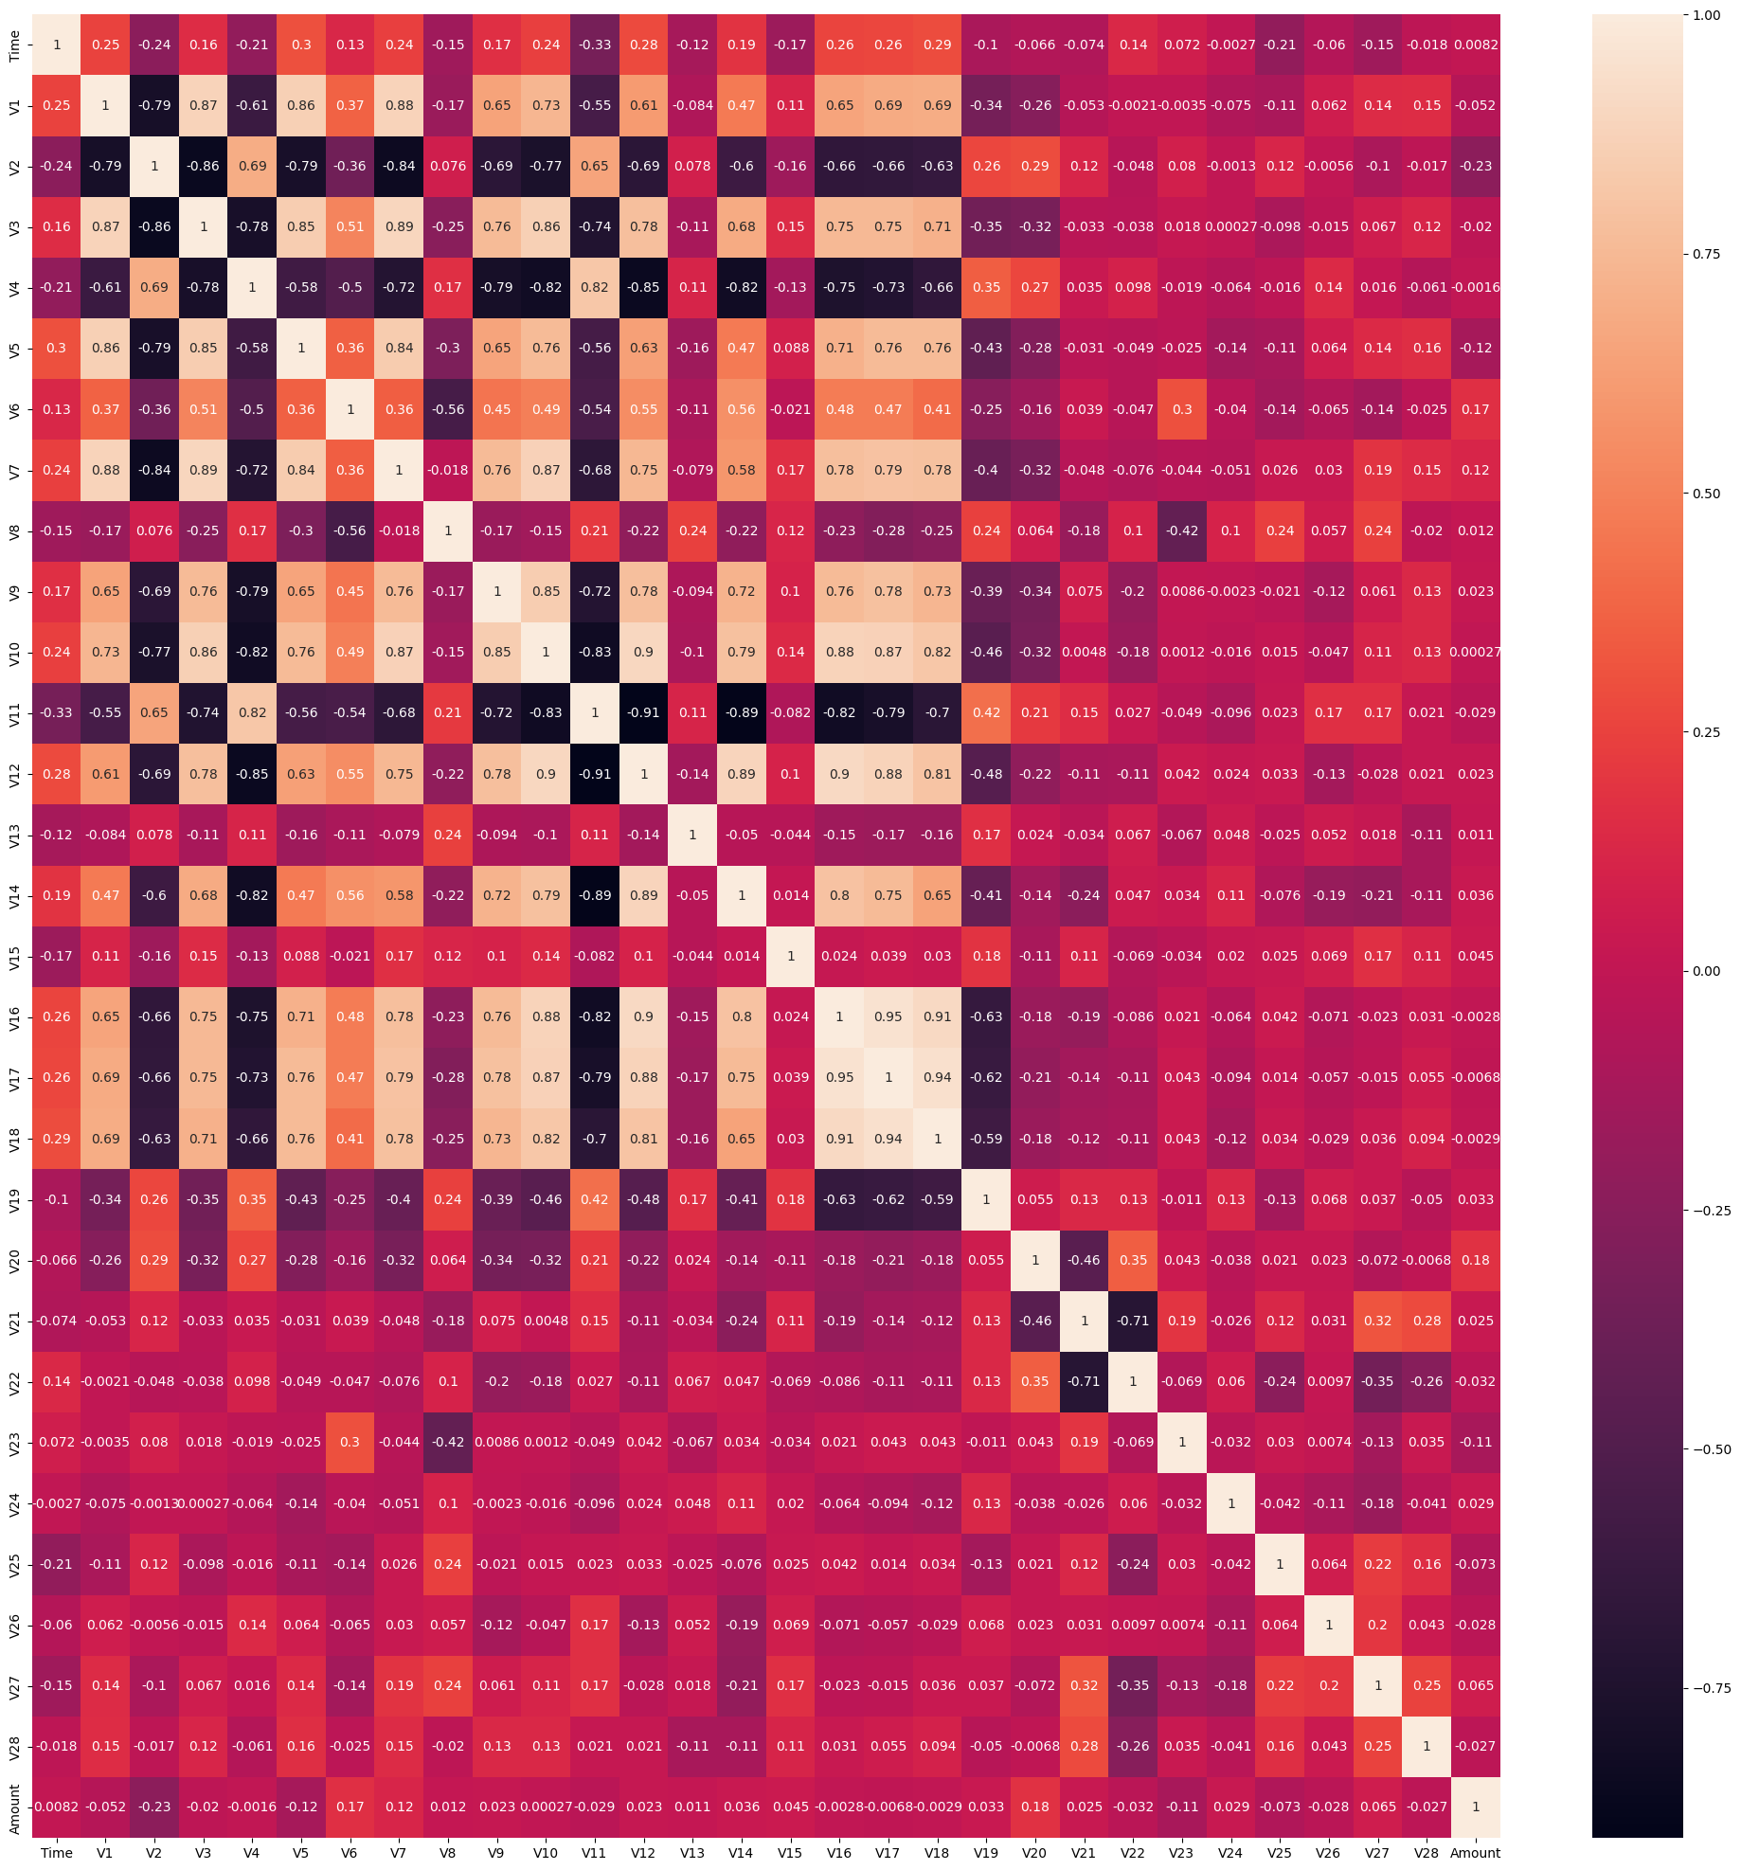
Feature Selection Techniques
Correlation
Figure. Correlation before SMOTE
Figure. Correlation after SMOTE

Slide 13
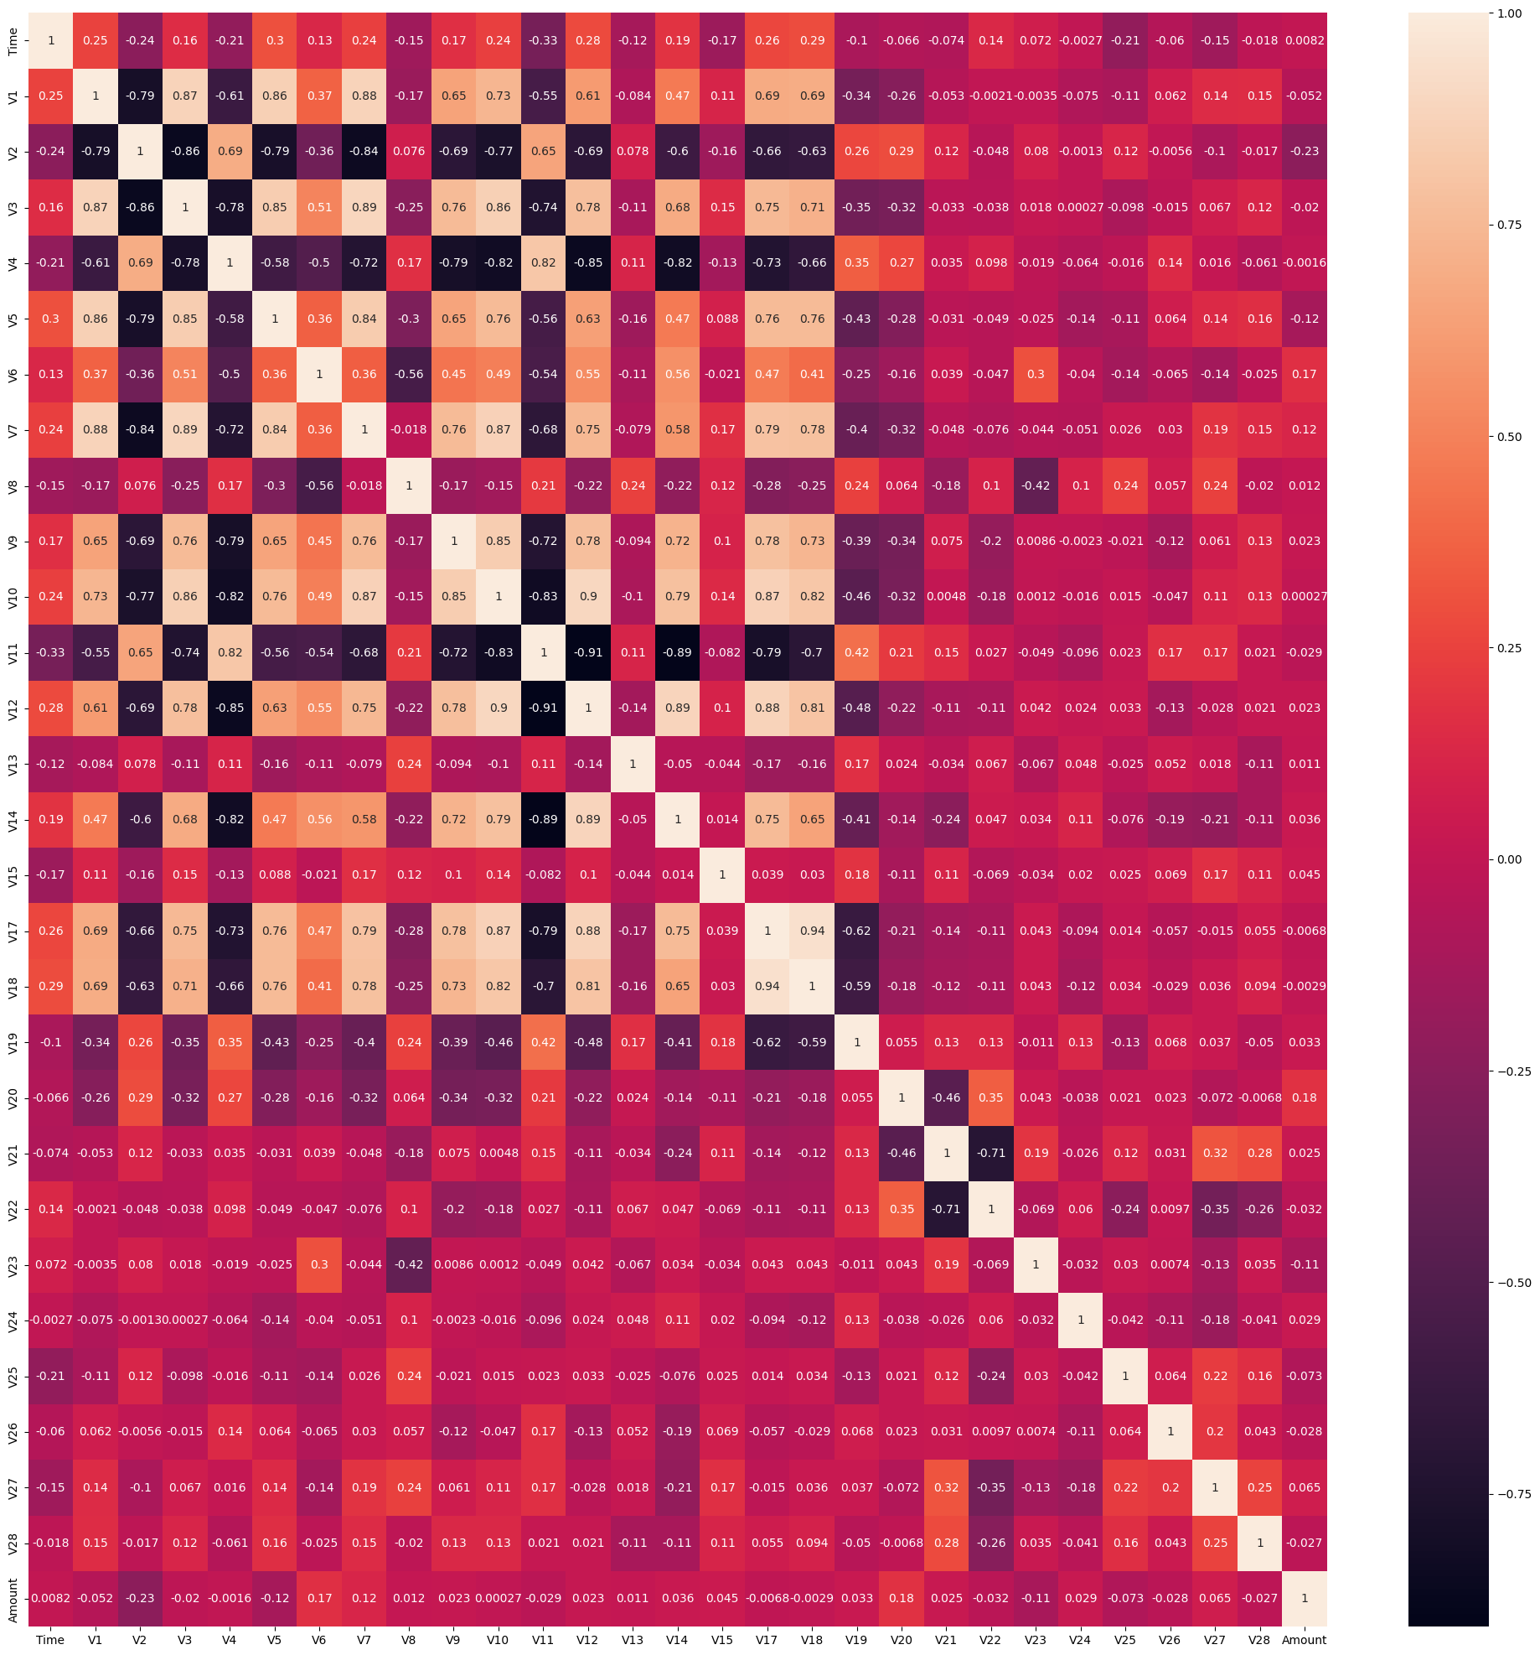
Feature Selection Techniques
Correlation
Remove correlated features
Remove highly correlated features by using the Pearson correlation formula.
Using threshold value 0.95 to identify highly correlated features
V16 and V17 cross this threshold value so we remove here the V16 feature from the dataset.
Now there only 29 features.
FIG- CORRELATION
Figure. After remove correlated Correlated feature

Slide 14
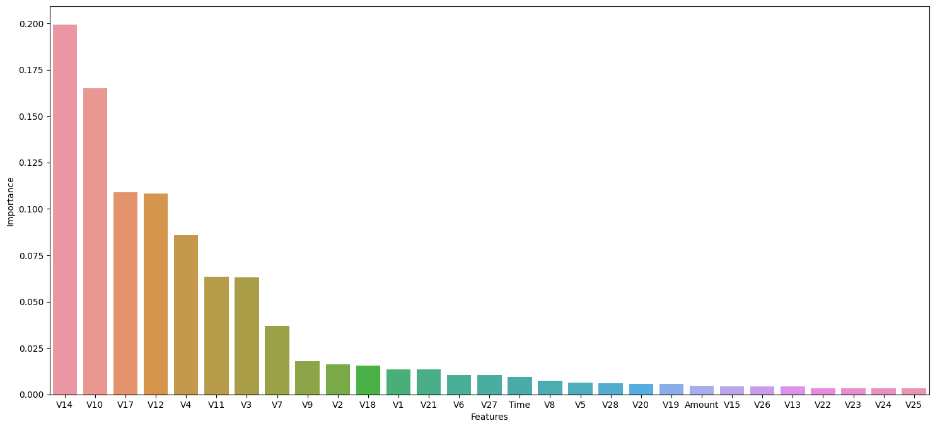
Feature Selection Techniques Random Forest Feature Importance
Applying random forest importance method for selecting important features using optimal threshold value 0.015.
Now 29 features reduced to 14 important features.
In figure we can see 'V14', 'V10', 'V17', 'V12', 'V4', 'V11', 'V3', 'V7', 'V9', 'V2','V18', 'V1', 'V21', 'V6' columns are the top selected features the importance value are more than 0.015
Figure: RF feature importance

Slide 15
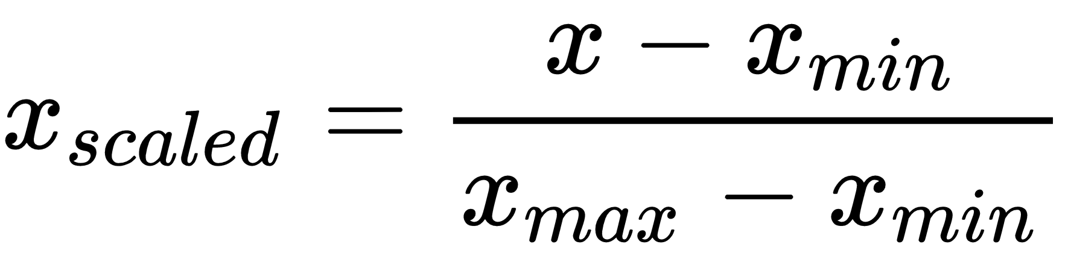
Feature Selection Techniques
Normalization
Min-Max Normalization
Applied to the selected features to convert them in range between 0 and 1.
It converts the input data in a standard format.
Training speed and model performance will be better than before.
Reduce the value range of different features.
‹#›

Slide 16
Genetic Algorithm(GA)
It is an evolutionary algorithm working methodology is inspired by the famous Charles Darwin’s theory.
It has 4 features: population, gene, chromosome and fitness value.
ALGORITHM OF GA:
Step 1 : Initialization of population
Step 2 : set N = no. of generation
Step 3: set i=1
Step 4: while i<= N
calculate the fitness value
Selection
Crossover
Mutation

Slide 17
Genetic Algorithm(GA)
Operation in GA:
Initialization of population: The first step where random individuals of the populations are represented as a sequence of binary string called chromosome.
Fitness value: Calculate each population fitness value. Choosing individuals for mating based on their fitness value (parents) and desired values for each is the evaluation procedure.
Selection: The selection of an individual is depends on its fitness value. The higher fitness value has more probability for selection than the lower value.
Crossover: After selecting individuals then we perform crossover operation for creating new generation. There are many technique of crossover operation :single point ,two point and multi point crossover.
Parent 1 : 1101100100110110
Parent 2: 1101111000011110
Crossover at point 5 the new generation
Child 1 :11011 11000011110
Child 2:1101100100110110

Slide 18
Genetic Algorithm(GA)
Mutation: after creating the new generation by using the crossover operation then we need mutation for changing the characteristics of this new generation
Child 1 : 1101111000011110
Child 2: 1101100100110110
After mutation by randomly select bits 0 to 1 and vice versa.
Muted child 1 : 1100111000011110
Muted child 2 : 1101101100110100

Slide 19
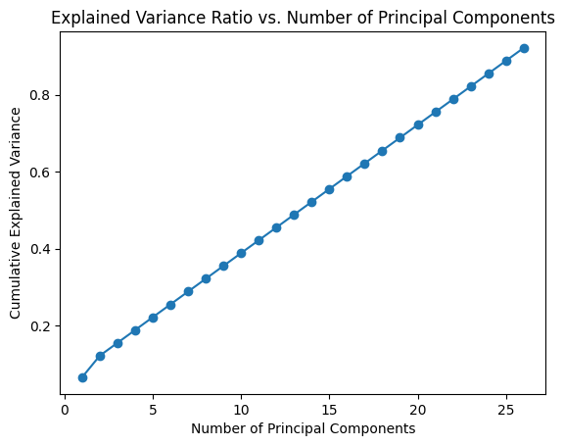
Principal Component Analysis (PCA)
It is a feature extraction technique.
The goal is to create a new, smaller set of features that contain the most useful data.
Minimize the dimensionality of dataset.
Reduce the amount of input features.
This figure present the number of principal
components which can retain more than 90% variance of the original dataset.
26 principal components are selected as they retain more than 90% variance of the original dataset.
Figure: Cumulative Explained Variance Ration vs. Number of Principal Components

Slide 20
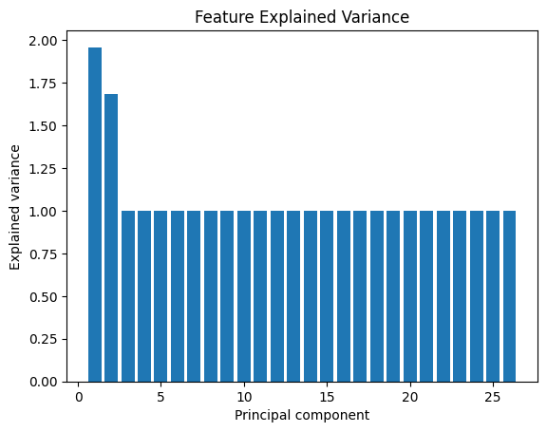
Principal Component Analysis (PCA)
The figure shows the relationship between the explained variance and the number of principal components.
Principal component 1 and 2 have contain the highest explained variance where as Principal component 3 to 26 have contain the same explained variance.
Figure: Explained Variance Ration vs. Number of Principal Components
Notes:
Our remaining slides presentation by Mostafizur Rahman

Slide 21
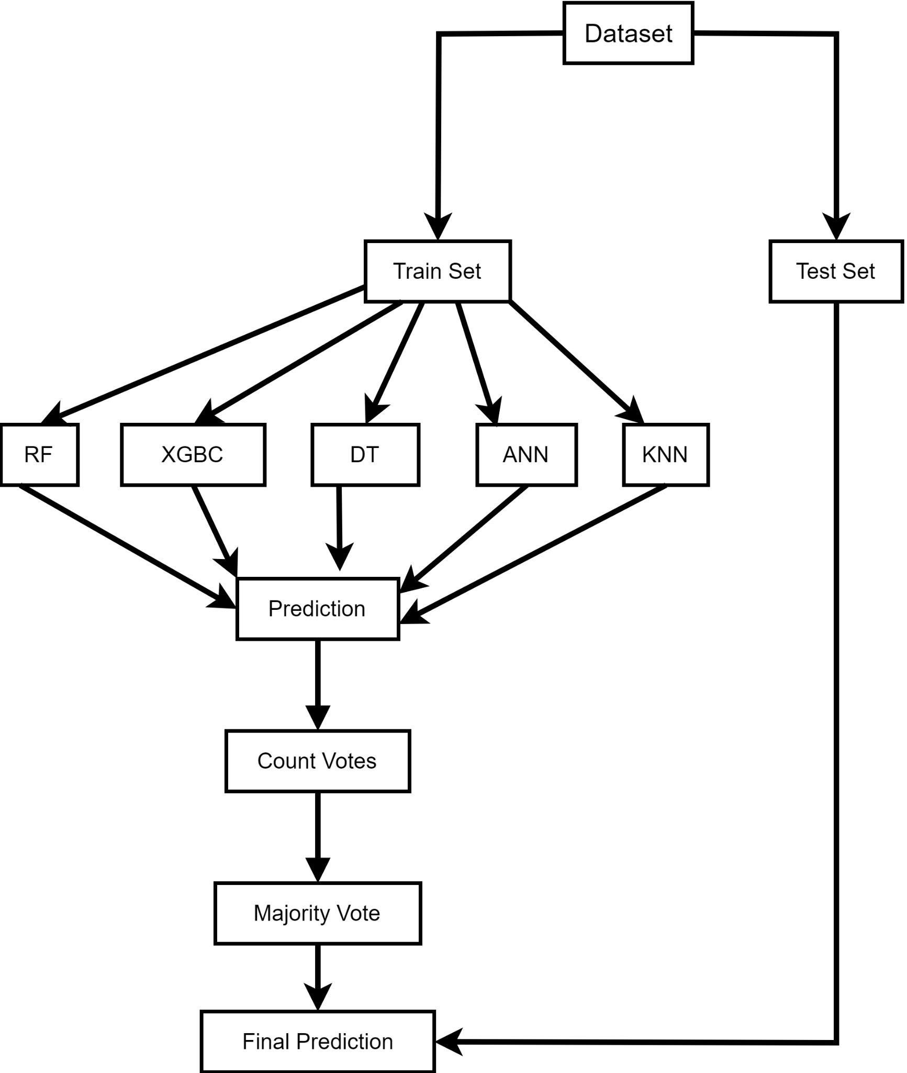
Ensemble Learning (Voting)
Combine Models Predictions
Works on Majority vote(hard voting)
Base Classifiers: DT, RFT, XGBC, ANN, KNN
Reduce variance and improve prediction accuracy
Robustness of model Prediction
Faster
Figure: Ensemble voting(majority)

Slide 22
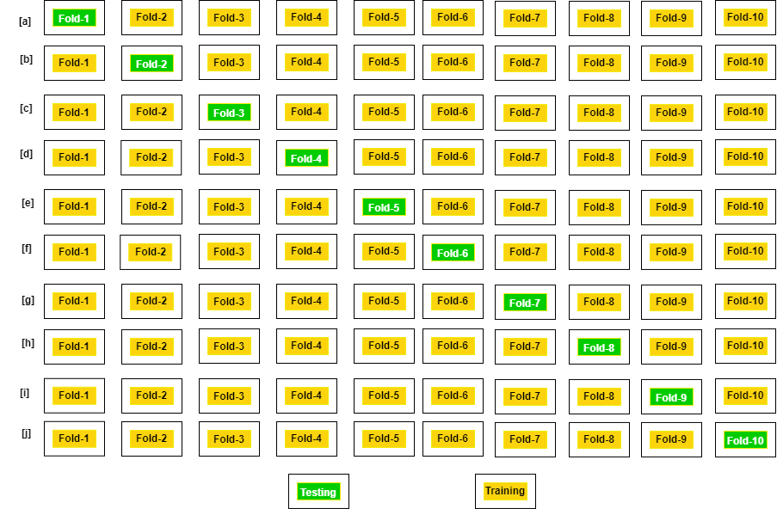
Experimental Results (10 Fold Cross Validation)
10 fold cross validation on 5 models (XGBC, DTC, RFC, ANN, KNN) on the train dataset and calculate their performance metric (accuracy , F1 measure).

Slide 23
Experimental Results (10 Fold Cross Validation)
RFC performed better in each fold than XGBC another 3 models are not performed as RFC and XGBC.
Fold | XGBC |  | DTC |  | RFC |  | ANN |  | KNN
 | ACC | F1 | ACC | F1 | ACC | F1 | ACC | F1 | ACC | F1
1 | 99.97 | 99.97 | 99.87 | 99.87 | 99.97 | 99.97 | 97.09 | 97.13 | 98.06 | 98.06
2 | 99.99 | 99.99 | 99.86 | 99.86 | 99.99 | 99.99 | 92.78 | 92.23 | 98.03 | 98.03
3 | 99.99 | 99.99 | 99.87 | 99.87 | 99.99 | 99.99 | 97.95 | 97.96 | 97.99 | 98.08
4 | 99.98 | 99.98 | 99.86 | 99.86 | 99.98 | 99.98 | 97.50 | 97.45 | 97.97 | 98.12
5 | 99.99 | 99.99 | 99.85 | 99.85 | 99.99 | 99.99 | 97.24 | 97.97 | 98.05 | 98.05
6 | 99.98 | 99.99 | 99.89 | 99.89 | 99.99 | 99.99 | 98.14 | 98.12 | 98.10 | 98.10
7 | 99.98 | 99.98 | 99.85 | 99.85 | 99.99 | 99.99 | 98.09 | 98.06 | 98.03 | 98.03
8 | 99.98 | 99.98 | 99.88 | 99.88 | 99.98 | 99.98 | 97.80 | 97.79 | 98.10 | 98.10
9 | 99.98 | 99.98 | 99.87 | 99.87 | 99.98 | 99.98 | 97.23 | 79.32 | 97.99 | 97.99
10 | 99.98 | 99.98 | 99.85 | 99.85 | 99.99 | 99.99 | 97.88 | 97.45 | 97.99 | 97.99
Avg. | 99.98 | 99.98 | 99.86 | 99.86 | 99.99 | 99.99 | 97.12 | 97.06 | 98.05 | 98.06

Slide 24
Experimental Results (all models)
Method | Performance Metric | XGBC | RF | DT | ANN | KNN | Ensemble Voting | Speed
Method -1 ( Feature selection ) | ACC | 99.94 | 99.95 | 99.79 | 98.87 | 99.92 |  | Very Fast
 | F1 | 85.42 | 88.20 | 58.86 | 21.56 | 80.76
 | Time | 0.24 | 0.35 | 0.007 | 0.94 | 17.65
Method-2 ( PCA ) | ACC | 99.92 | 99.93 | 99.79 | 99.93 | 99.93 |  | Not slow
 | F1 | 81.98 | 83.41 | 60.68 | 80.55 | 82.67
 | Time | 0.57 | 0.25 | 0.007 | 0.14 | 64.36
Method-3 ( GA ) | ACC | 99.93 | 99.94 | 99.92 | 99.90 | 99.92 |  | Very Slow
 | F1 | 87.00 | 86.85 | 85.86 | 83.06 | 85.40
 | Time | 2.58 | 16.19 | 0.54 | 14.89 | 43.22
Method-4 ( Ensemble Majority Voting ) | ACC | 99.94 | 99.95 | 99.85 | 92.13 | 97.03 | 99.94 | Very Slow
 | F1 | 84.97 | 85.41 | 65.83 | 3.90 | 6.31 | 85.42
 | Time | 0.14 | 0.17 | 0.008 | 0.155 | 142.52 | 314.31

Slide 25
Experimental Results (Comparative Analysis on different methods )
Method-1 (Feature Selection):
Very fast
Random Forest shows the highest accuracy (99.95%) and F1 score (88.20)
Method-2 (PCA):
Reduces dimensionality
Does not provide good performance
Method-3 (Genetic Algorithm):
Very slow execution
Less suitable for real-time systems.
Method-4 (Ensemble Voting):
Better accuracy compared to the PCA and GA methodologies.
But extremely slow

Slide 26
Experimental Results(Model Selection)
Chosen Model
Feature Selection with Random Forest
Best accuracy (99.95%) and F1 score (88.20)
Some reasons for selecting Feature Selection:
Enhanced Model Performance
Reduced Overfitting
Faster Training and testing time
Noise Reduction
Normalization for Consistency

Slide 27
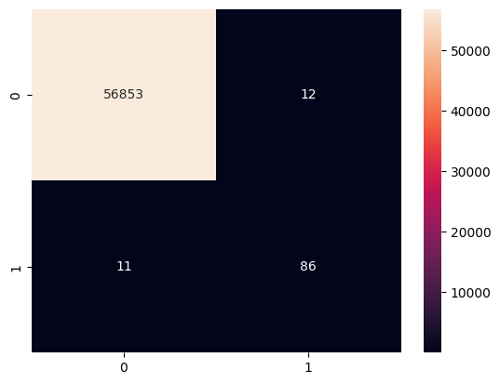
Experimental Results(Model selection)
Performance Metrics Results
High accuracy and F1 score.
Less number of FP and FN that means low Type-I and Type-II error.
Misclassified samples is approximately 0.0404%.
ROC-AUC and PR score is high in Random forest.
Figure: Confusion Matrix

Slide 28
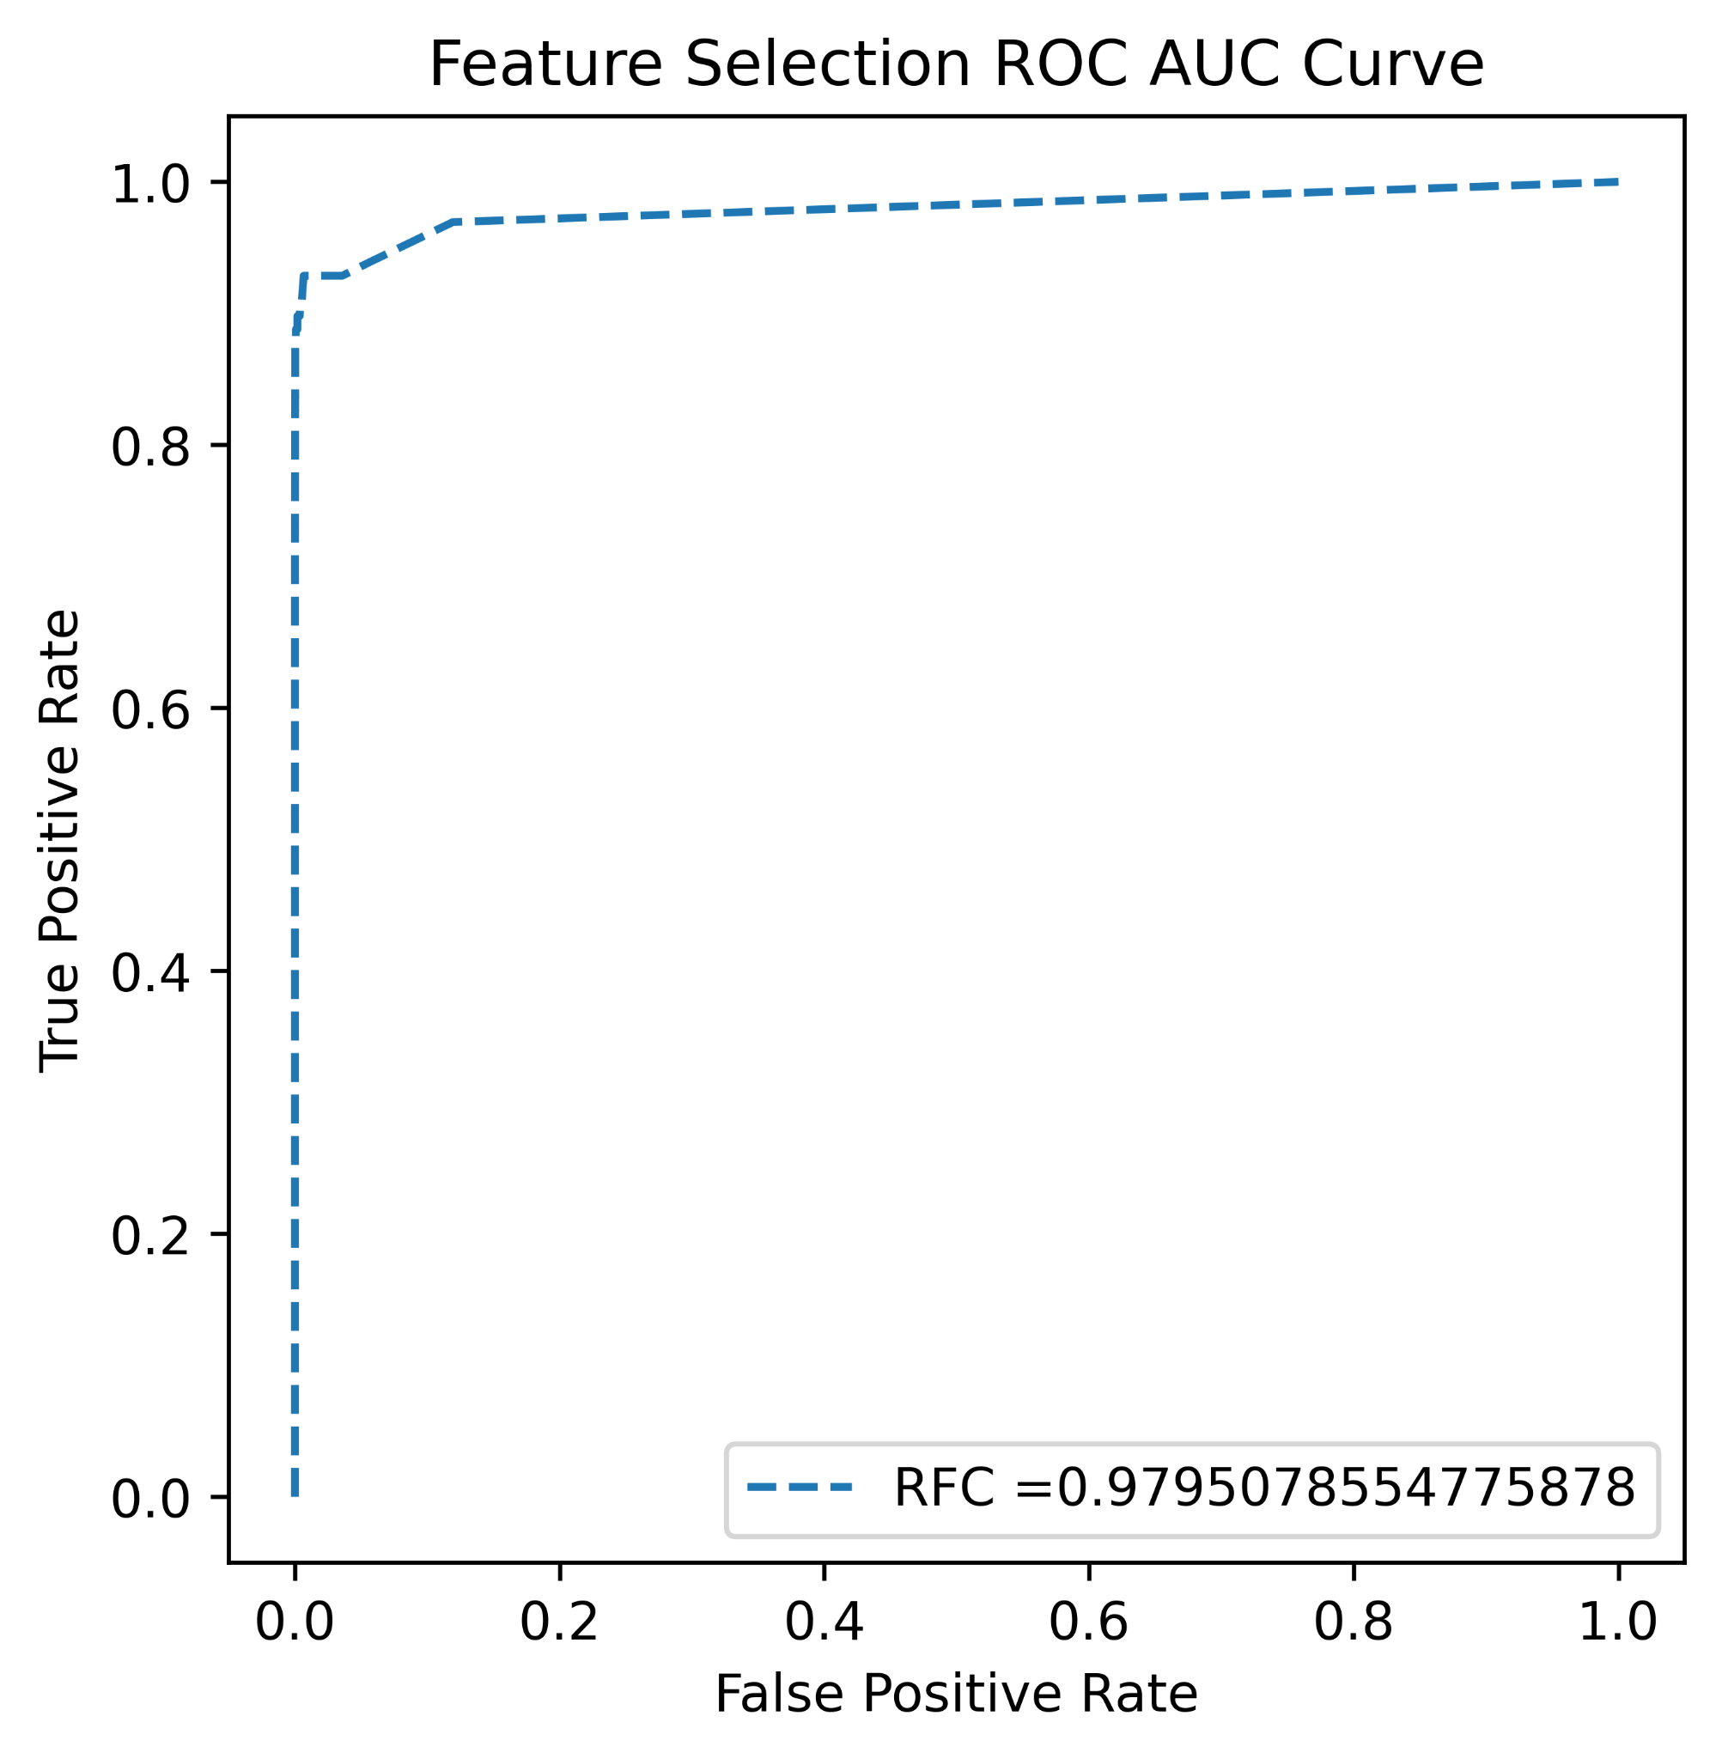
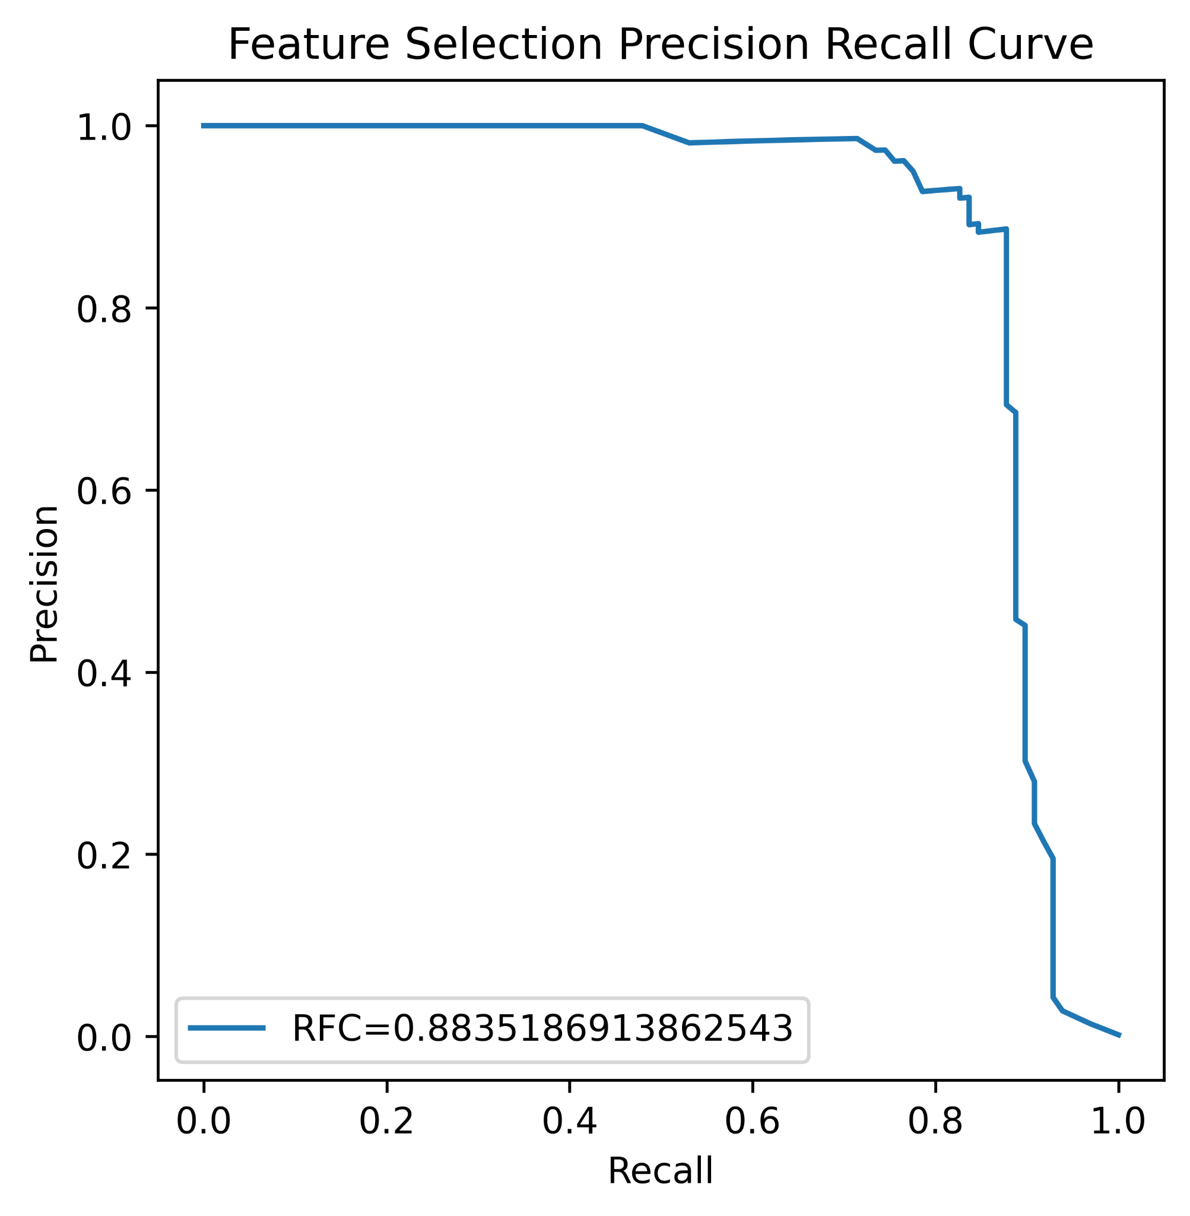
EXPERIMENTAL RESULTS (Model Selection)
Figure: ROC curve for RF in Feature Seleciton method
Figure: PR curve for RF in Feature Seleciton method

Slide 29
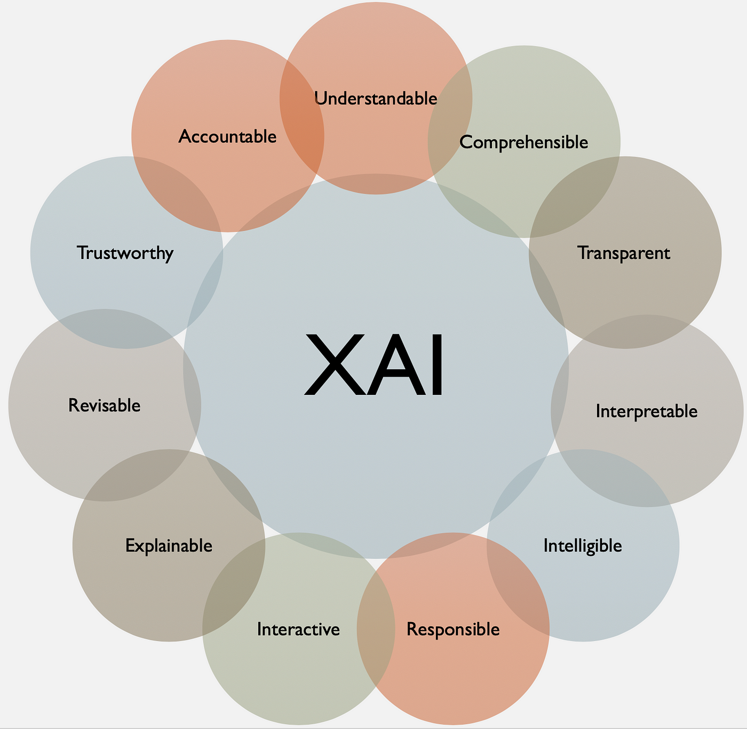
XAI (Explainable Artificial Intelligence)
Explainable Artificial Intelligence (XAI) has models explainability
Solution for better understanding of model’s prediction.
Expose Black-box nature of AI models
Makes Model transparent, trustworthy, and accountable
It’s always free from bias

Slide 30
XAI (Explainable Artificial Intelligence)(Contd.)
Model-Agnostic Methods:
Techniques applicable across different types of models, such as LIME (Local Interpretable Model-agnostic Explanations) and SHAP (SHapley Additive exPlanations).
SHAP (SHapley Additive exPlanations):
SHAP is a unified framework based on cooperative game theory
Adds shape values(contribution values) to each features showing how each feature contributes to the model’s predictions.
It provides fairness, flexibility and visual tools.

Slide 31
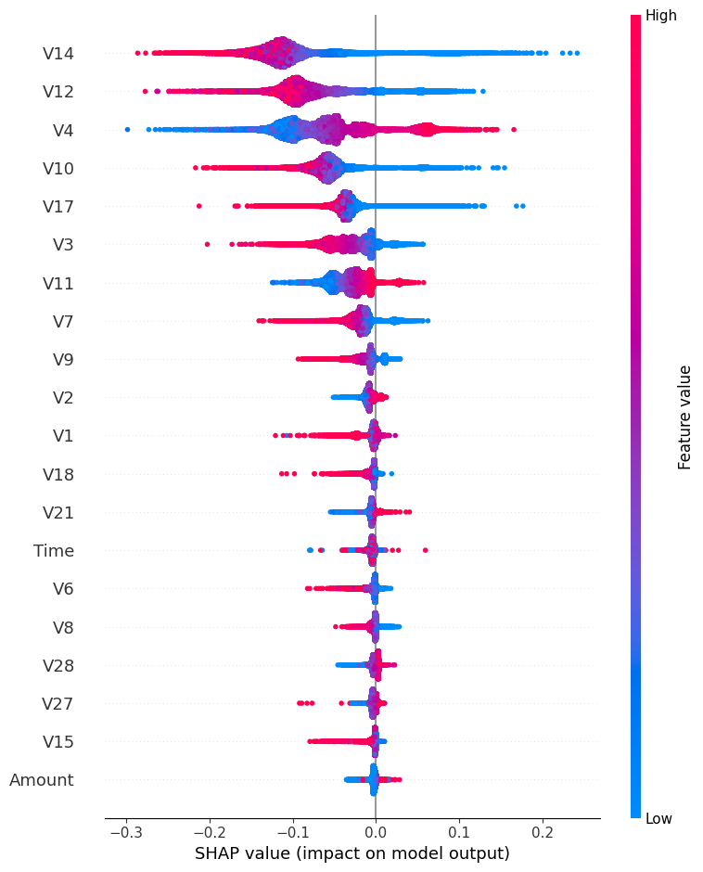
XAI (Explainable Artificial Intelligence)(Contd.)
SHAP visualization
Beeswarm summary plot visualizes and validates of our selected features.
X-axis represents shap values and vertical gradient bar represents feature values.
Importance of various features in descending order.
Any feature with shap value greater than zero has stronger positive impact on the model.
Our selected features from Feature Selection method are same as SHAP plotted features
Figure: XAI SHAP on RF

Slide 32
EXPERIMENTAL RESULTS
Our Proposed Model vs. Current State-of-the-Art Models
Reference Papers | Models | No. of features | Performance
 |  |  | Accuracy | F1-score
Ileberi, E. et al. (2022) [3] | GA-RF | 9 | 99.93% | 79.26%
Sohony, I. et al. (2018) [6] | Ensemble voting | 30 | 99.95% | 86.29%
Varmedja, D. et al. (2019) [7] | LR | 27 | 97.46% | 11.05%
Khare, N., & Sait, S. Y. (2018). [9] | RF | 30 | 98.6% | -
Yılmaz, A. A. (2023) [10] | PSO-RF | 30 | 99.92% | 82.63%
Our approach | Feature Selection, RF | 14 | 99.95% | 88.20%

Slide 33
Limitations
Although there is small amount of FP and FN that model can’t accurately detect some times.
As there is larger number of legitimate transactions compared to fraudulent ones so this unbalanced dataset solve with an artificial technique SMOTE which is not perfect all time.
To enhance fraud detection accuracy, organizations often collect and analyze large amounts of sensitive data where data privacy sometimes faces challenges.

Slide 34
Conclusion
Collection of dataset from Kaggle [13] containing card transactions
Completing pre-processing of dataset and dividing the dataset into train and test split.
Then applying SMOTE- sampling technique
Applying different methods and select the best one.
Deploying dataset into machine learning algorithms
Comparing different performance metrics and choosing the best model.
Finally we interpret our selected model using Expalinable AI(XAI)

Slide 35
References
[1] Khatri, S., Arora, A., & Agrawal, A. P. (2020, January). Supervised machine learning algorithms for credit card fraud detection: a comparison. In 2020 10th international conference on cloud computing, data science & engineering (confluence) (pp. 680-683). IEEE.
[2] Srivastava, A., Kundu, A., Sural, S., & Majumdar, A. (2008). Credit card fraud detection using hidden Markov model. IEEE Transactions on dependable and secure computing, 5(1), 37-48.
[3] Ileberi, E., Sun, Y., & Wang, Z. (2022). A machine learning based credit card fraud detection using the GA algorithm for feature selection. Journal of Big Data, 9(1), 24.
[4] Sahin, Y., & Duman, E. (2011, June). Detecting credit card fraud by ANN and logistic regression. In 2011 international symposium on innovations in intelligent systems and applications (pp. 315-319). IEEE.
[5] Itoo, F., Meenakshi, & Singh, S. (2021). Comparison and analysis of logistic regression, Naïve Bayes and KNN machine learning algorithms for credit card fraud detection. International Journal of Information Technology, 13(4), 1503-1511.
[6] Sohony, I., Pratap, R., & Nambiar, U. (2018, January). Ensemble learning for credit card fraud detection. In Proceedings of the ACM India joint international conference on data science and management of data (pp. 289-294).

Slide 36
References(Contd.)
[7] Varmedja, D., Karanovic, M., Sladojevic, S., Arsenovic, M., & Anderla, A. (2019, March). Credit card fraud detection-machine learning methods. In 2019 18th International Symposium INFOTEH-JAHORINA (INFOTEH) (pp. 1-5). IEEE.
[8] Li, C., Ding, N., Dong, H., & Zhai, Y. (2021). Application of credit card fraud detection based on CS-SVM. International Journal of Machine Learning and Computing, 11(1), 34-39.
[9] Khare, N., & Sait, S. Y. (2018). Credit card fraud detection using machine learning models and collating machine learning models. International Journal of Pure and Applied Mathematics, 118(20), 825-838.
[10] Yılmaz, A. A. (2023). A machine learning-based framework using the particle swarm optimization algorithm for credit card fraud detection. Communications Faculty of Sciences University of Ankara Series A2-A3 Physical Sciences and Engineering, 66(1), 82-94.
[11] Ogwueleka, F. N. (2011). Data mining application in credit card fraud detection system. Journal of Engineering Science and Technology, 6(3), 311-322
[12] Dubey, S. C., Mundhe, K. S., & Kadam, A. A. (2020, May). Credit card fraud detection using artificial neural network and backpropagation. In 2020 4th international conference on intelligent computing and control systems (ICICCS) (pp. 268-273). IEEE.

Slide 37
References(Contd.)
[13] Kaggle.com. (2024). Credit Card Fraud Detection. [online] Available at: https://www.kaggle.com/mlg-ulb/creditcardfraud [Accessed 7 January. 2024].

Slide 38
Submission of Paper
Paper Title: Incorporating Feature Fusion Engineering and Ensemble Learning for Effective Credit Card Fraud Detection.
On ICCIT 2024
27th International Conference On Computer and Information Technology,
Organized By IEEE Bangladesh Section.

Slide 39
Thank You

